Slide 1
Geometric transformations
Advanced Graphics Programming

Slide 2
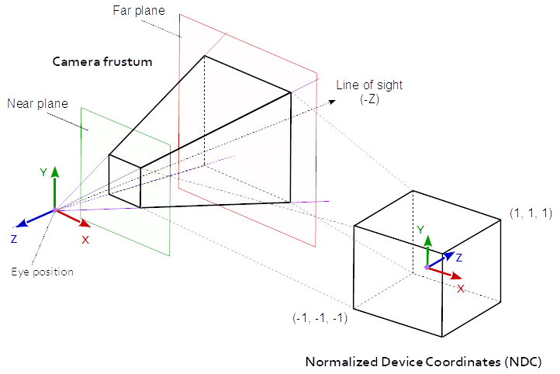

Slide 3
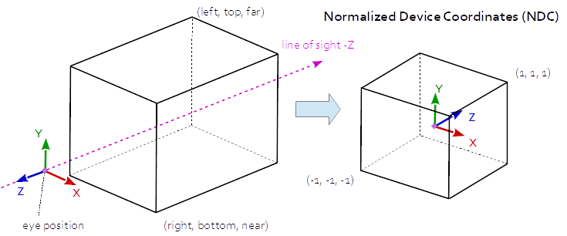

Slide 4
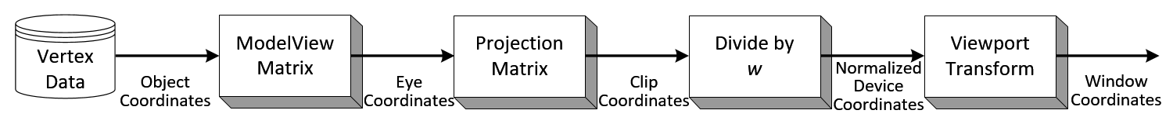
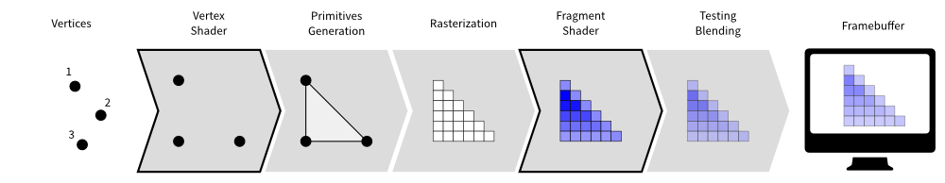

Slide 5
glLoadIdentity
glMatrixMode
glPushMatrix
glPopMatrix
NOT ANYMORE

Slide 6
Shader program introspection
https://www.khronos.org/opengl/wiki/Program_Introspection

